Slide 1

Customer Shopping Behavior Analysis
Uncovering insights from 3,900 purchases to guide strategic business decisions through data-driven analysis of spending patterns, customer segments, and product preferences.

Slide 2

Dataset Overview
3,900
18
50
Total Purchases
Data Features
Locations
Comprehensive transaction records analyzed
Columns capturing customer and purchase details
Geographic diversity across customer base
25
Product Types
Diverse inventory across categories
The dataset encompasses customer demographics (age, gender, location, subscription status), purchase details (item, category, amount, season, size, color), and shopping behavior (discounts, promo codes, previous purchases, frequency, review ratings, shipping type). Only 37 missing values were found in the Review Rating column.

Slide 3

Data Preparation & Cleaning
Python Analysis Process
Key Statistics
We began with comprehensive data preparation using pandas to ensure data quality and consistency.
Average Age: 44 years (range: 18-70)
Average Purchase: $59.76 (range: $20-$100)
Loaded dataset and explored structure with df.info() and .describe()
Average Rating: 3.75 out of 5.0
Gender Split: 68% Male, 32% Female
Imputed missing Review Rating values using median by category
Subscription Rate: 27% subscribed
Standardized columns to snake_case format
Discount Usage: 43% of purchases
Created age_group and purchase_frequency_days features
Verified data consistency and removed redundant columns
Integrated cleaned data into PostgreSQL database

Slide 4
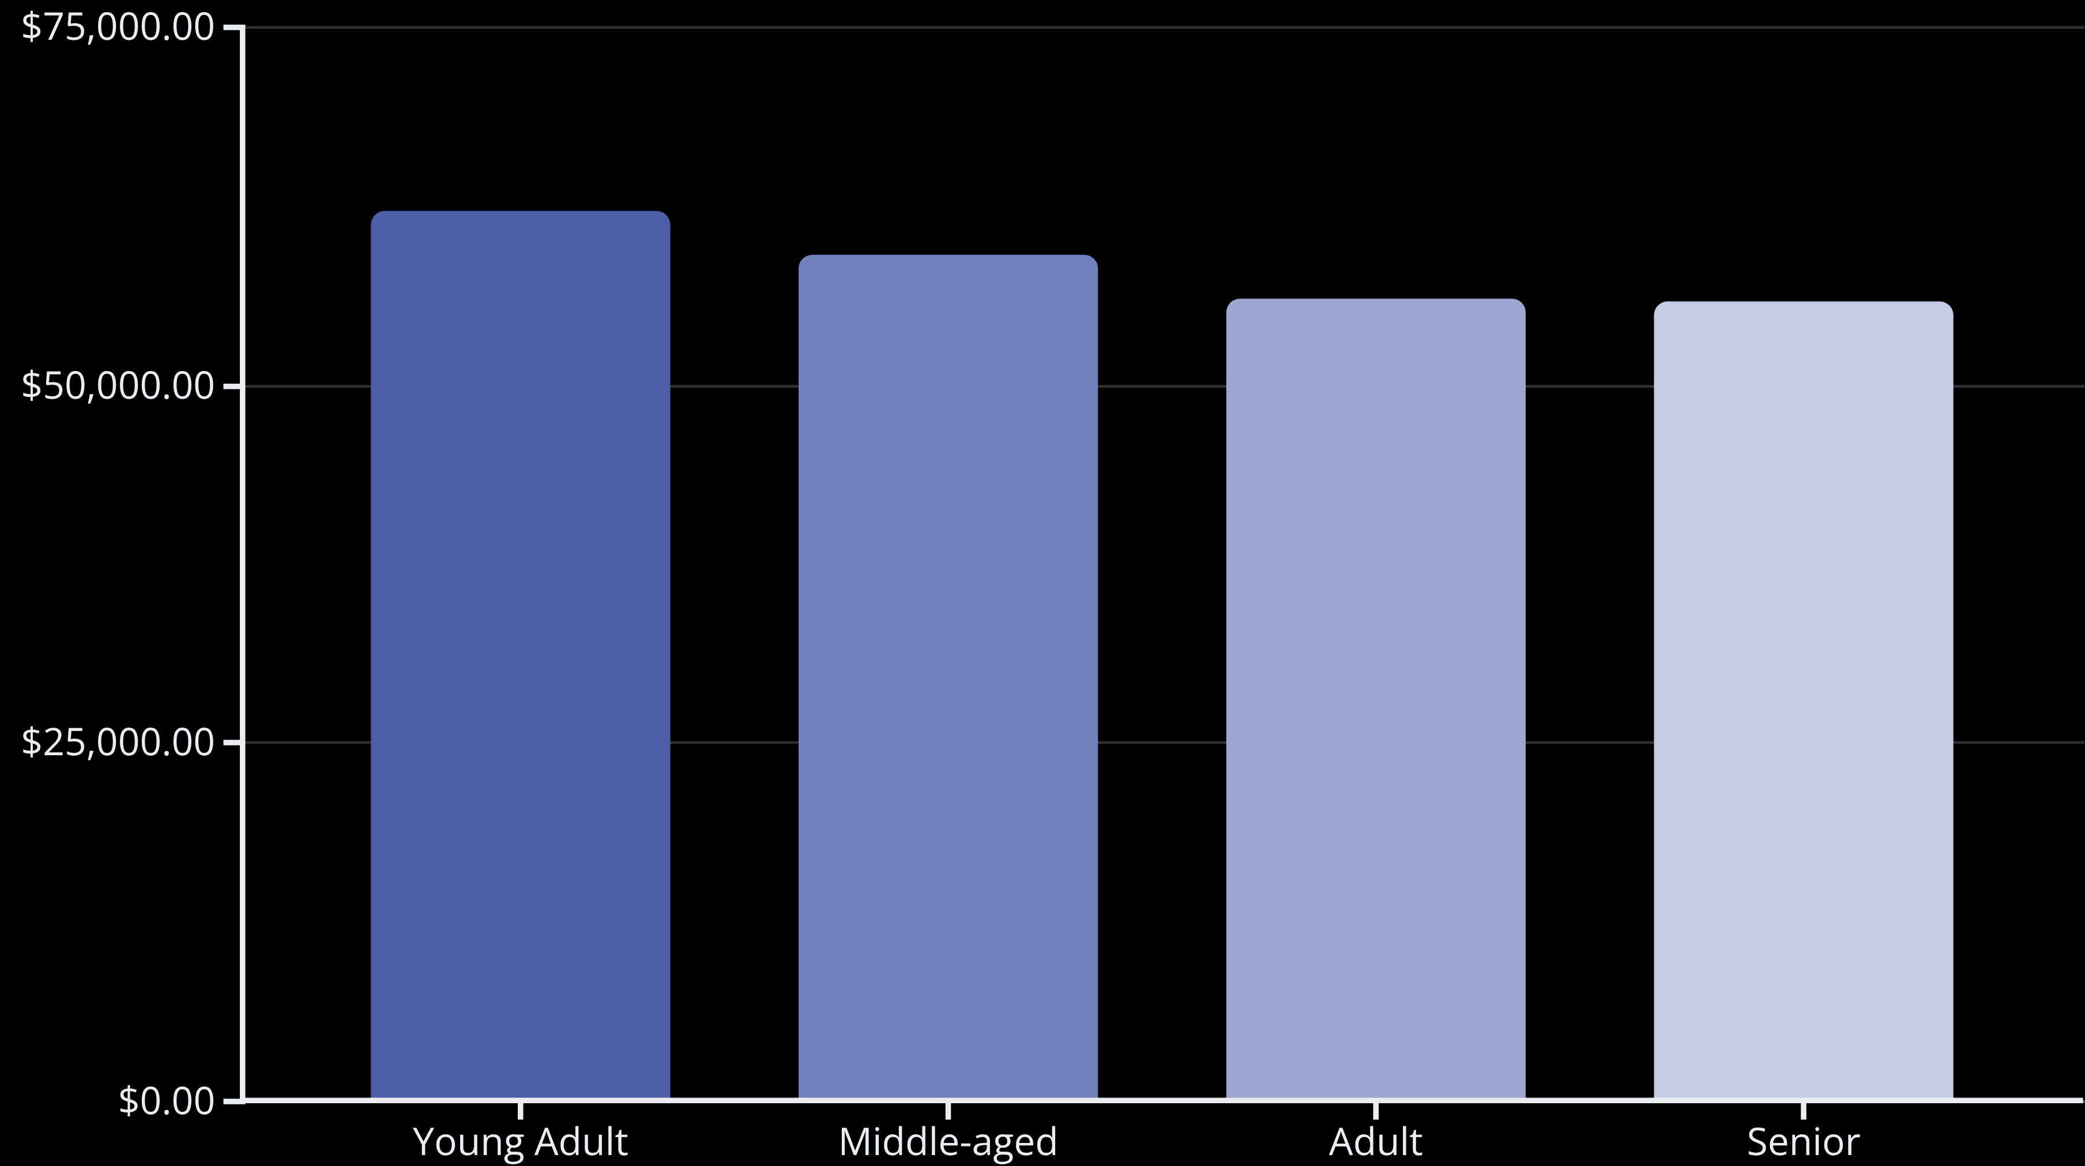
Revenue Insights by Demographics
Male Customers
Female Customers
$157,890 total revenue
$75,191 total revenue
Representing 68% of customer base and driving the majority of sales volume
32% of customer base with opportunities for targeted growth strategies
Revenue by Age Group
Young adults lead revenue generation, followed closely by middle-aged customers. Revenue distribution is relatively balanced across age groups, suggesting broad market appeal.

Slide 5
Product Performance Analysis
Top-Rated Products
Most Purchased by Category
01
02
Accessories: Jewelry (171), Sunglasses (161), Belt (161)
Gloves - 3.86 rating
Sandals - 3.84 rating
Clothing: Blouse (171), Pants (171), Shirt (169)
03
04
Footwear: Sandals (160), Shoes (150), Sneakers (145)
Boots - 3.82 rating
Hat - 3.80 rating
05
Outerwear: Jacket (163), Coat (161)
Skirt - 3.78 rating

Slide 6




Discount Strategy Analysis
50%
49.7%
Hat
Sneakers
Highest discount rate
Second highest discount dependency
49.1%
48.2%
Coat
Sweater
Strong discount usage
Frequent discount purchases
Analysis revealed 839 high-spending customers who used discounts but still purchased above the average amount of $59.76. This suggests discounts effectively drive sales without necessarily reducing overall transaction values. Five products show particularly high discount dependency, with hats leading at 50% of purchases using discounts.

Slide 7

Shipping & Purchase Behavior
Key Insights
Express Shipping
Express shipping users spend $2.02 more on average, indicating a correlation between urgency and purchase value. This presents an opportunity to promote premium shipping options to increase overall transaction values.
$60.48 average purchase
Higher spending customers prefer faster delivery options
Standard Shipping
$58.46 average purchase
Shipping preferences vary across customer segments, with loyal customers more likely to choose express options.
Slightly lower average but represents majority of orders

Slide 8




Customer Segmentation
Loyal
3,116 customers
Returning
701 customers
New
83 customers
Customer segmentation based on purchase history reveals a strong loyal customer base representing 80% of all customers. This indicates successful retention strategies, though the small new customer segment (2%) suggests opportunities for acquisition growth.
Subscription Analysis
Subscribers: 1,053 customers with $59.49 average spend generating $62,645 total revenue
Non-Subscribers: 2,847 customers with $59.87 average spend generating $170,436 total revenue
Among repeat buyers with more than 5 purchases, 958 are subscribers while 2,518 are not, indicating significant opportunity to convert loyal customers into subscribers.

Slide 9
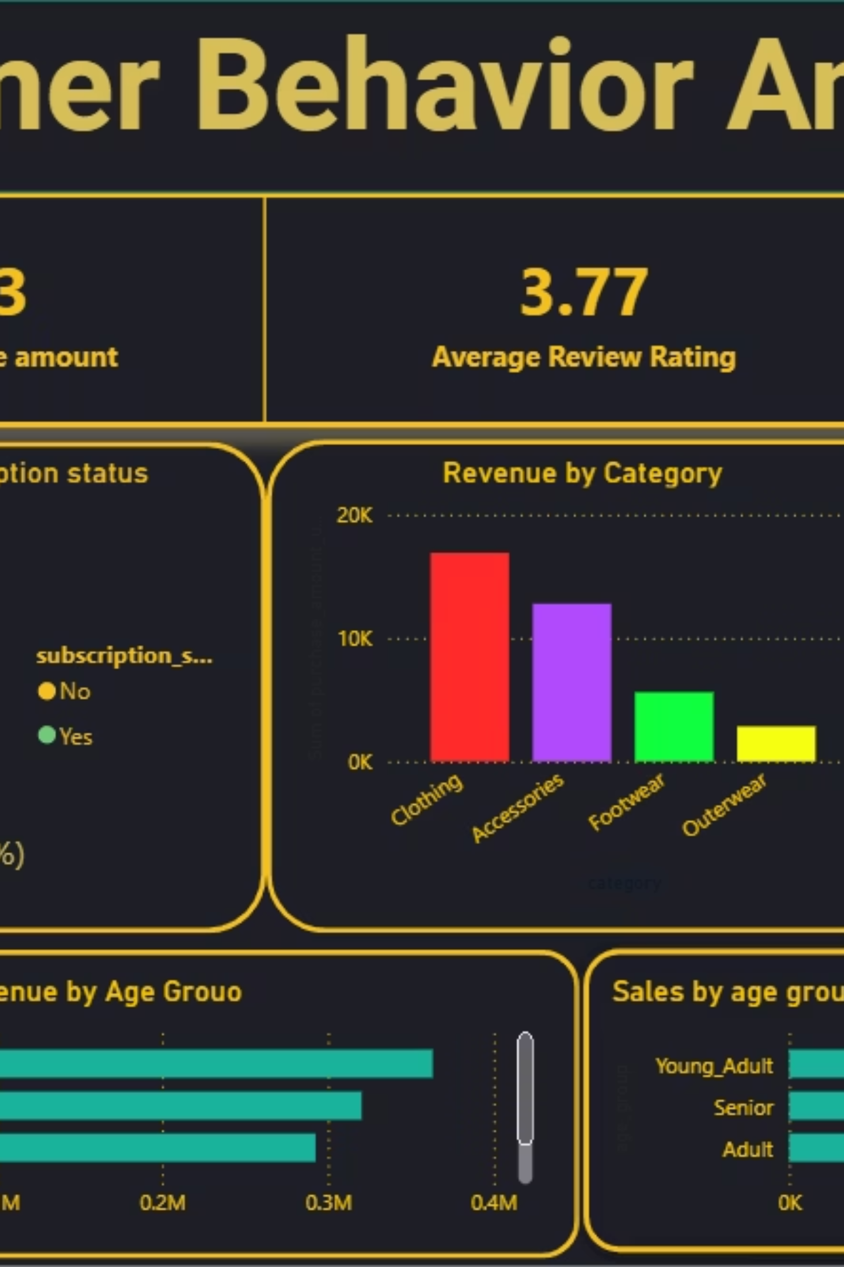
Interactive Dashboard Insights
The Power BI dashboard provides real-time visualization of key metrics across customer behavior, revenue patterns, and product performance. Interactive filters enable stakeholders to explore data by subscription status, gender, category, and shipping type.
Customer Metrics
3,900 total customers with detailed demographic and behavioral tracking
Financial Performance
$59.76 average purchase amount with revenue breakdowns by multiple dimensions
Quality Indicators
3.75 average review rating tracking customer satisfaction across products

Slide 10





Strategic Recommendations
Boost Subscriptions
Promote exclusive benefits for subscribers to convert the 2,518 repeat buyers who aren't currently subscribed. Focus on loyalty rewards and early access to new products.
Customer Loyalty Programs
Reward repeat buyers to accelerate their journey into the "Loyal" segment. Implement tiered benefits based on purchase frequency and lifetime value.
Review Discount Policy
Balance sales boosts with margin control. Focus discounts on strategic products while maintaining profitability on high-rated items that sell well without promotions.
Product Positioning
Highlight top-rated products (Gloves, Sandals, Boots) and best-sellers (Jewelry, Blouse, Pants) in marketing campaigns to drive conversion.
Targeted Marketing
Focus efforts on high-revenue age groups (Young Adults, Middle-aged) and express-shipping users who demonstrate higher purchase values and urgency.

